Slide 1

HAPTIC
RETARGETING
GRUPPO 9
Dario Doronzo, Davide Trenti,
Fabiola Polidoro, Giovanni Forcelli

Slide 2




PROJECT BY
Mahdi Azmandian, Mark Hancock, Hrvoje Benko, Eyal Ofek, Andrew D. Wilson

Slide 3
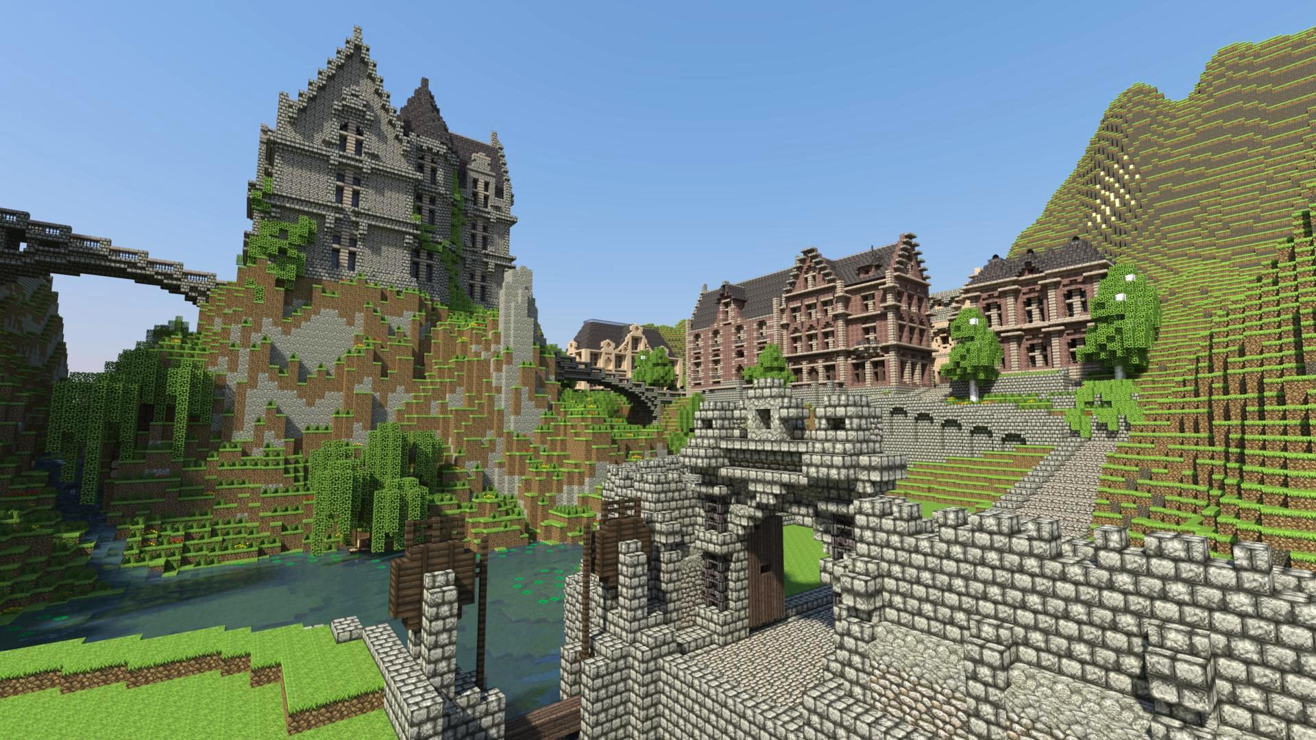
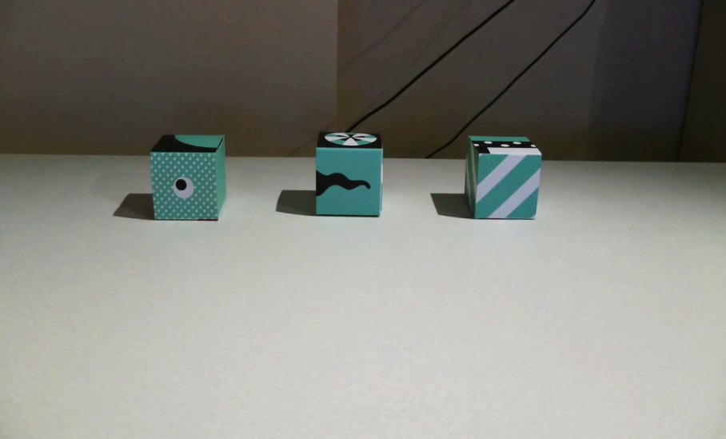
minecraft

Slide 4
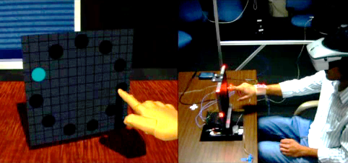
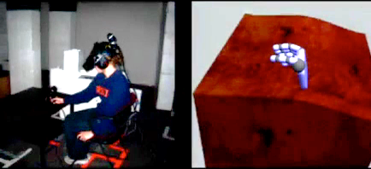
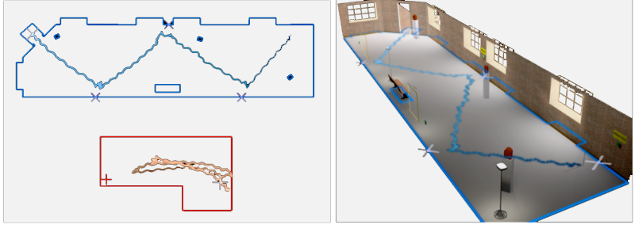
Related works
REDIRECTED TOUCHING
REDIRECTED WALKING

Slide 5
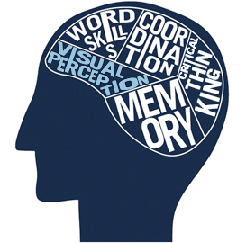
VISUAL PERCEPTION
When senses conflict vision often dominates
It influences:
Proprioception (Where I am)
Vestibular cues (Where I’m going)
These values can be scaled by:
Traslation:
+ 26% - 14%
Rotation:
+ 49% - 20%

Slide 6
GOALS
Repurpose the passive haptics of the same real physical objects across multiple virtual objects…
…by finding a mapping between real and virtual coordinates.
Requirements:
The mapping is Dynamic;
The mapping is minimally noticable;

Slide 7
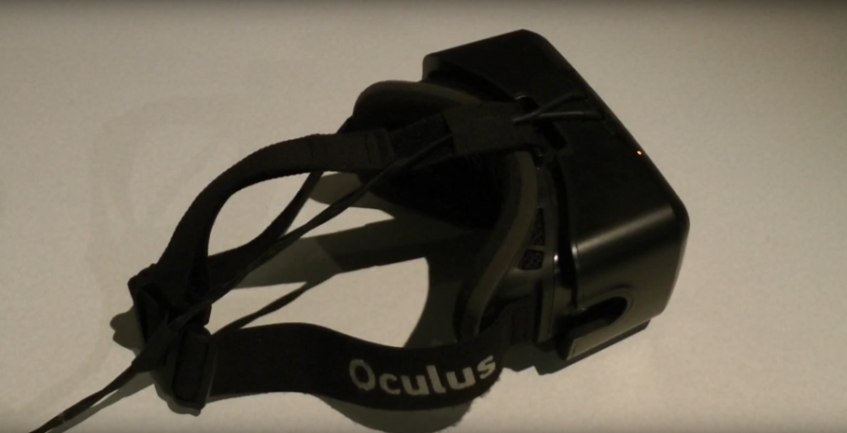
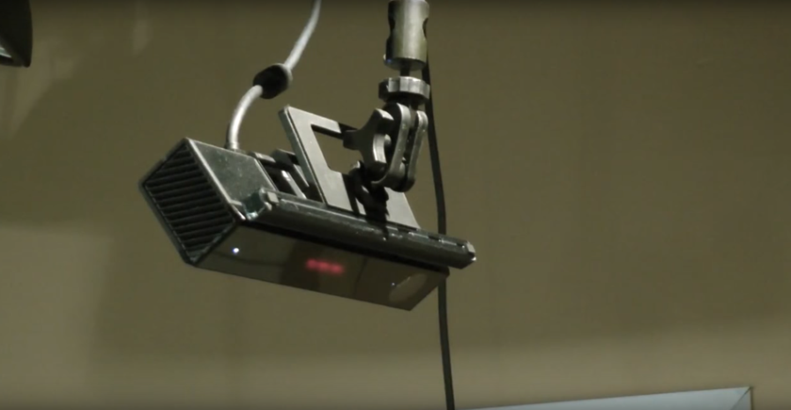
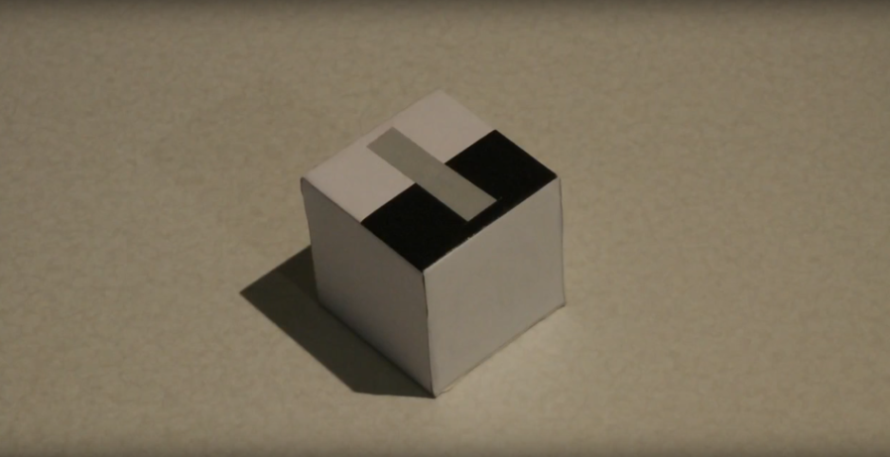
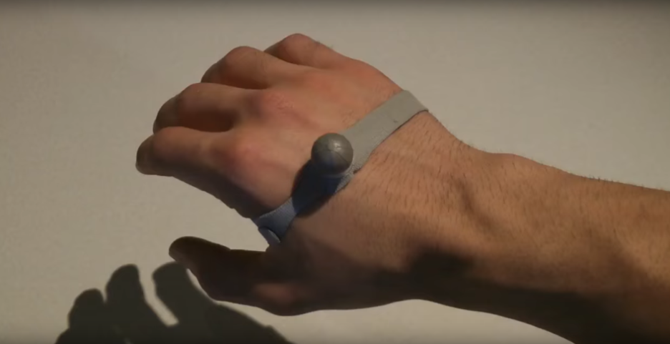
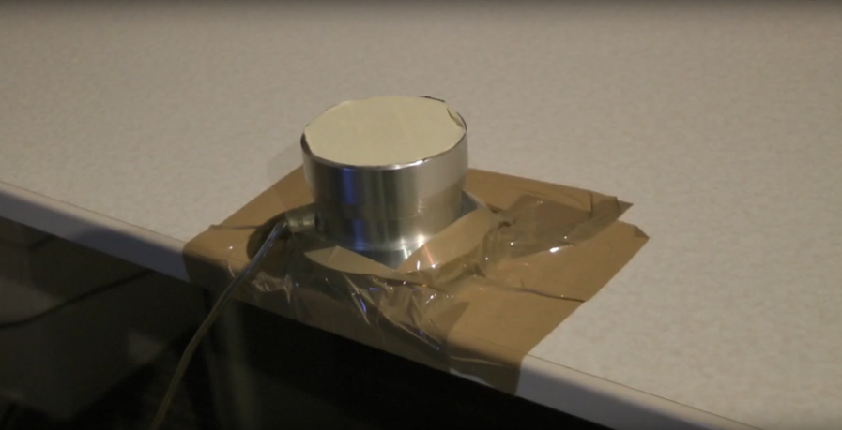
implementation
Oculus Rift dk2
Kinect
Tracked cube
Hand marker
Physic button

Slide 8
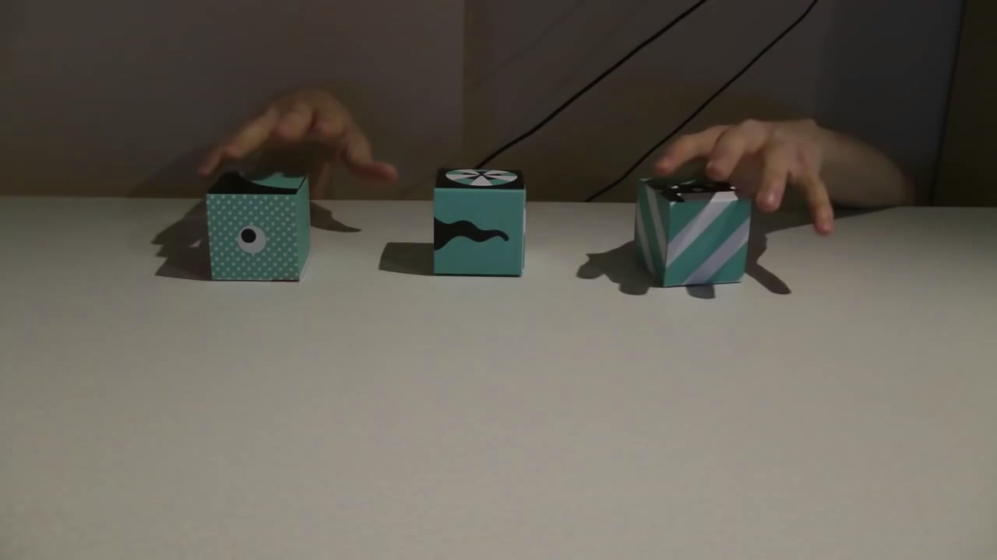
BODY WARPING

Slide 9
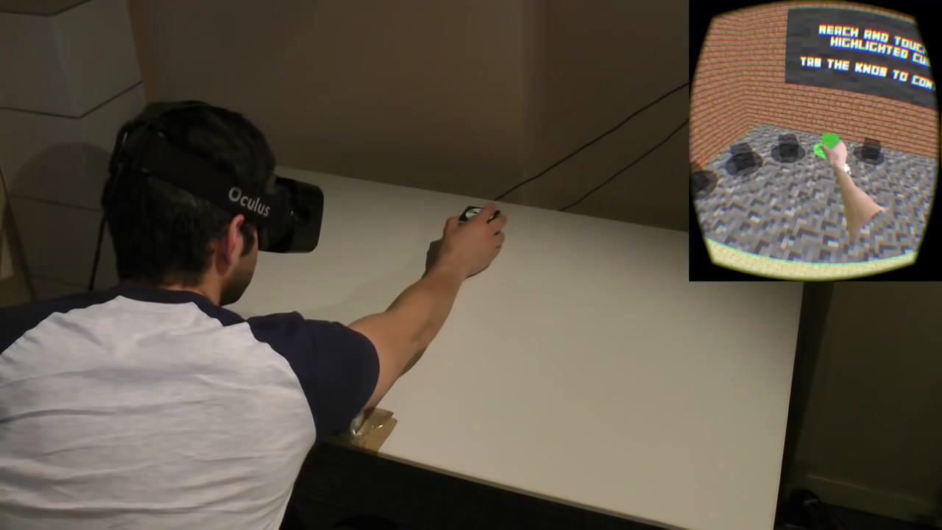
WORLD WARPING

Slide 10
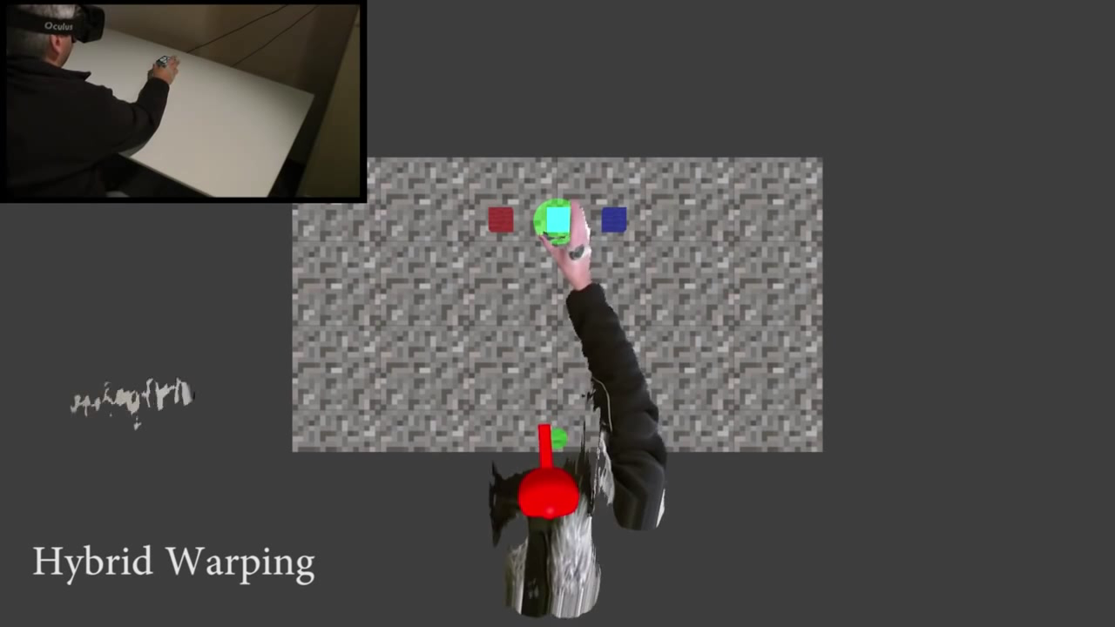
HYBRID WARPING

Slide 11
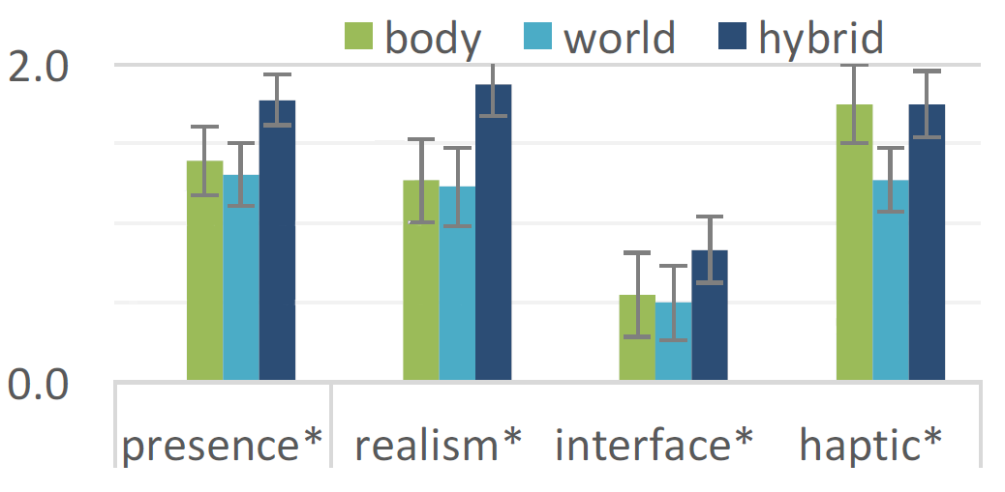
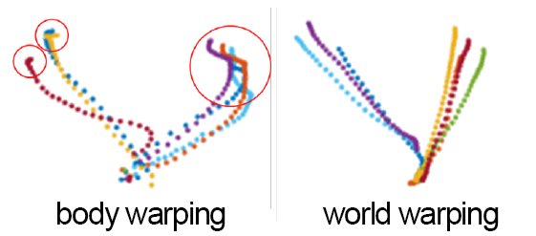
RESULTS
Precence analysis
Correction
BODY WARPING | WORLD WARPING
Always works Better to use slow movements | No corrections Requires head movements

Slide 12
Next steps
Investigate detection thresholds
Path prediction
Shape mapping
Advanced warping (eg. mesh deformation)

Slide 13
Thank you!
Questions?

